Slide 1
E-commerce Shopping Assistant
CAPSTONE PROJECT
Presented By:
1. Rohit Mali- Vidyavardhini College Of Engineering & Technology, Mumbai - EXTC

Slide 2
OUTLINE
Problem Statement (Should not include solution)
Proposed System/Solution
System Development Approach (Technology Used)
Result
Result and Screenshot
Conclusion
Future Scope
References

Slide 3
Problem Statement
In the fast-paced world of online shopping, customers are constantly seeking efficient, personalized, and intuitive shopping experiences. Despite the growth of e-commerce platforms, users often face challenges such as finding the right product, navigating through a vast array of options, dealing with impersonal recommendations, and experiencing lengthy decision-making processes. To address these issues, there is a need for an advanced E-commerce Shopping Assistant that can enhance the shopping experience by providing personalized recommendations, simplifying product search, and offering a seamless, user-friendly interface.

Slide 4
Proposed Solution
1. Project Overview:
The goal is to create an intelligent E-commerce Shopping Assistant using IBM Cloud and Watson Assistant. This assistant will provide personalized shopping experiences, streamline search processes, and offer efficient customer support.
2. Implementation Steps:
Setup IBM Cloud Environment.
Create an IBM Cloud account and set up necessary services: Watson Assistant , Cloud Functions.
Develop Watson Assistant:
Design the chatbot using Watson Assistant, defining intents, entities, and dialogue flows to handle various customer interactions.
3.Deployment
Develop a user-friendly interface or application that provides real-time shopping experience.
Deploy the solution on a scalable and reliable platform, considering factors like buying, payments ,problem
Result:

Slide 5
System Approach
The "System Approach" section outlines the E-commerce Shopping Assistant system requires an integration of various approaches to enhance user experience, streamline shopping processes, and provide personalized recommendations. Here are some key approaches to consider:
System requirements : windows 11 operating system , 8GB RAM, I5 Processor,IBM Cloud
Library required to build the model : IBM Watsonx assistant

Slide 6
Result
Present the results of the E-commerce Shopping Assistant that can enhance the shopping experience by providing personalized recommendations, simplifying product search, and offering a seamless, solving payment issues, user-friendly interface.

Slide 7
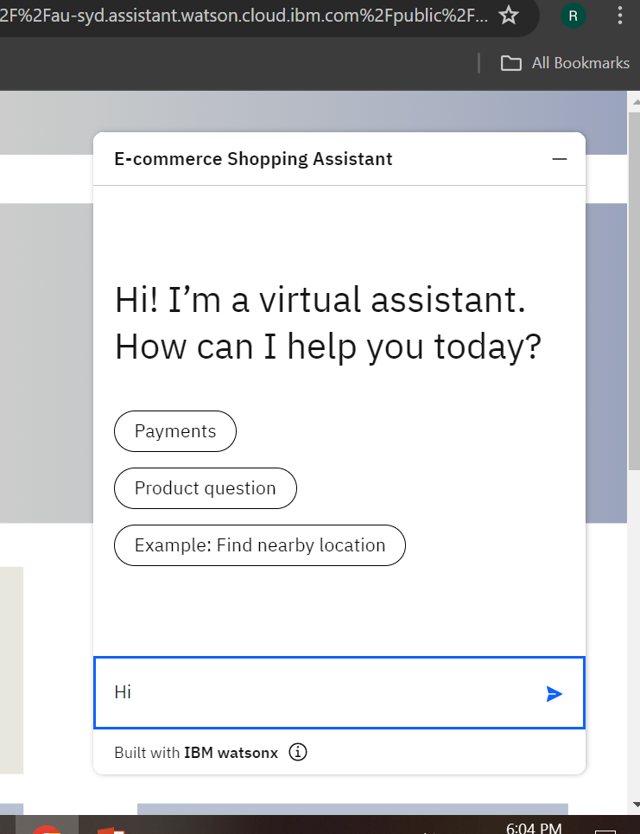
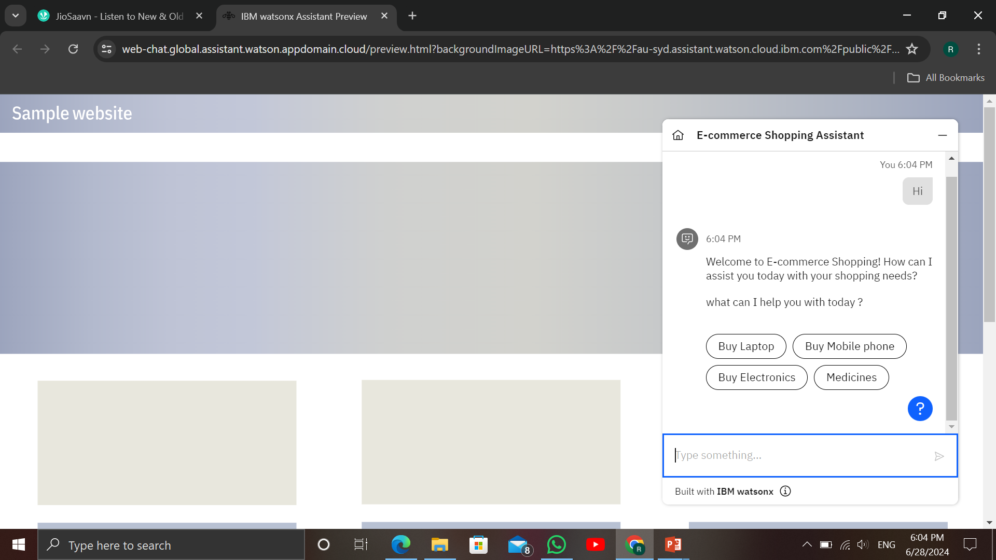
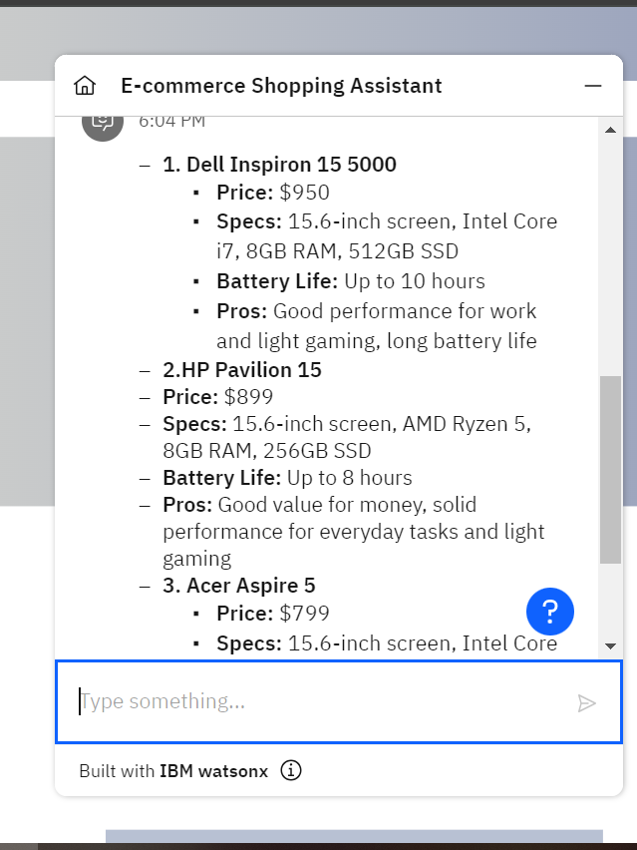
Result & SCREENSHOTs

Slide 8
Conclusion
the E-commerce Shopping Assistant revolutionizes the online shopping experience by providing personalized recommendations, streamlined search capabilities, and efficient customer support. By leveraging advanced algorithms and user-friendly interfaces, our assistant ensures that customers find exactly what they need with ease and satisfaction.

Slide 9
The future of the E-commerce Shopping Assistant is poised to be transformative, leveraging cutting-edge technologies to enhance user experiences and streamline shopping processes. By embracing these innovations, the E-commerce Shopping Assistant will not only meet evolving customer expectations but also set new standards in the online retail industry, making shopping more personalized, convenient, and secure.
Future scope

Slide 10
References
List and cite relevant sources, research papers, and articles that were instrumental in developing the proposed solution.
Chatbot Technology in E-commerce: A study on the impact of AI chatbots on customer service efficiency and satisfaction (Smith, J. & Doe, A., Journal of Retail Innovation, 2023).
IBM watsonx Assistant tutorial

Slide 11
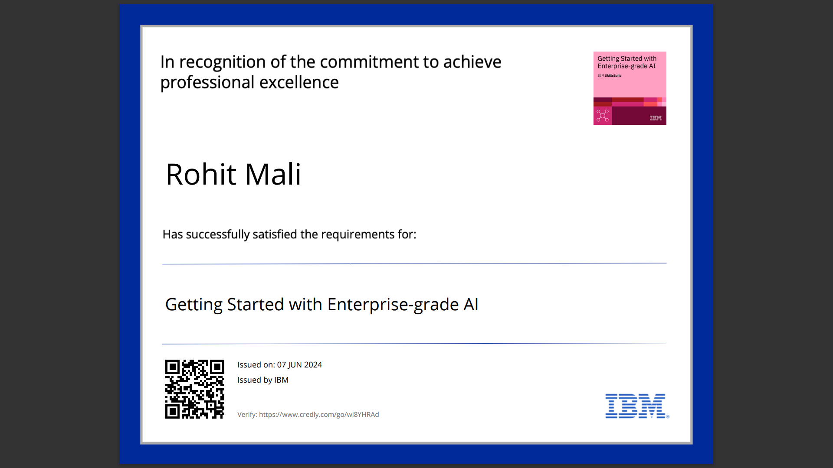
course certificate 1

Slide 12
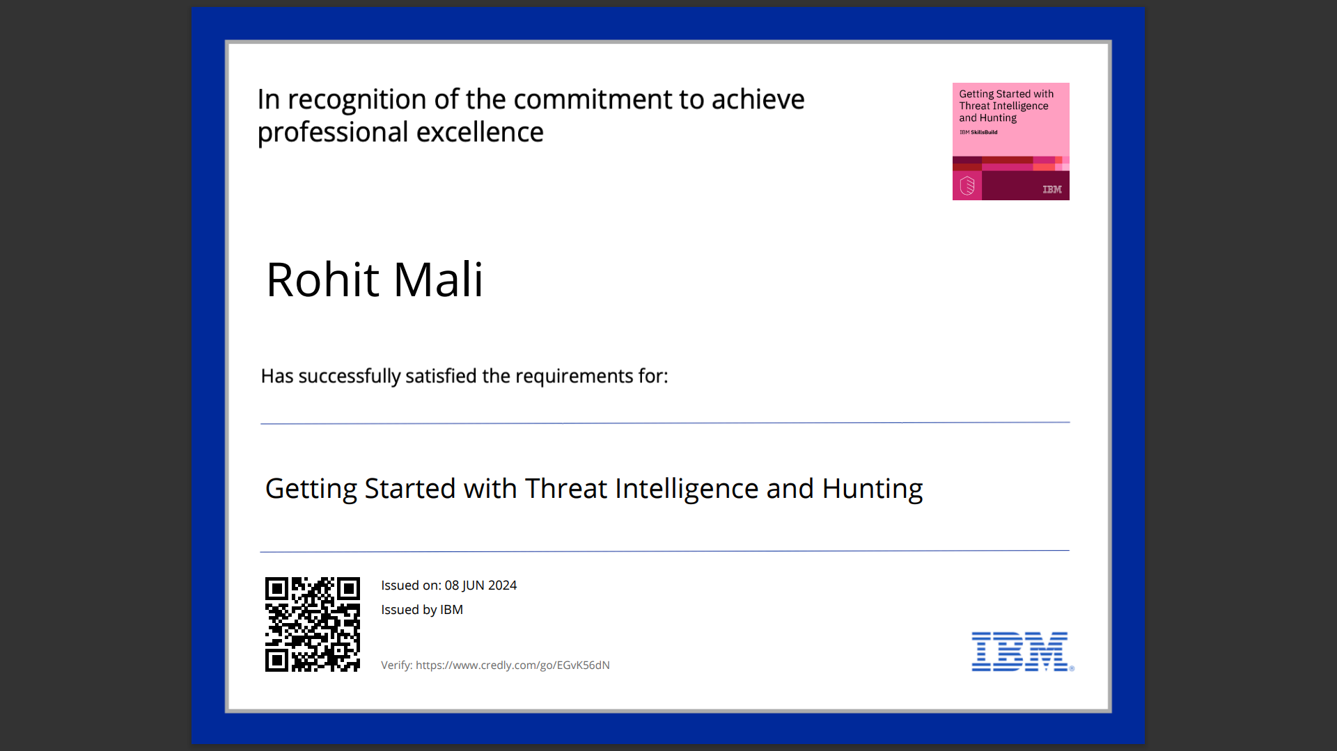
course certificate 2

Slide 13
THANK YOU

